Slide 1

Course : COMP6232 / Human - Computer Interaction
Year : 2016
UNDERSTANDING AND CONCEPTUALIZING INTERACTION
SESSION 02

Slide 2
LEARNING OUTCOMES
• LO 1: Describe the concept of interaction
design
• LO 2: Use guidelines, principles ,models,
and framework related with interaction
design

Slide 3
OUTLINE
^{Introduction}
^{Conceptual Models}
^{Interface Metaphor}
^{Interaction Types}
Paradigms , Theories, Models and Frameworks

Slide 4

INTRODUCTION
How would you start if asked to design an application to enable people to share their photos, movies, photo, chats, documents in an efficient, safe, and enjoyable way.
Would you begin by sketching out how the interface might look, work out how the system architecture should be structured or simply start coding ?
Would you start by asking users about their current experiences of sharing files and look existing tools , begin thinking about why and how you were going to design the application

Slide 5
INTRODUCTION
It is important for Interaction Designer to realize that having a clear understanding of why and how you are going to design something , before writing any code.
It can save enormous amounts of time, effort, and money later on in the design process.

Slide 6
CONCEPTUAL MODELS
A conceptual model provides a working strategy and a framework of general concepts and their interrelations.
The core components are :
  Metaphors and analogies that convey to people how to understand what a product is for and how to use it for an activity. ( ex browsing, bookmarking)
  The concepts that people are exposed to through the product, including the task-domain objects, the attributes, the operations. ( ex saving, revisiting, organizing)
  The relationships between those concepts
  The mappings between the concepts and the user experience the product is designed to support or invoke. ( ex : one can revisit, most frequently visited, or saved websites).

Slide 7
CONCEPTUAL MODELS
Example of a conceptual model
A classic conceptual model : The Star
  The Star interface developed by Xerox back in 1981 revolutionized the way interfaces were designed for personal computing.
  It was designed as an office system, targeted at workers not interested in computing and was based on a conceptual model that included the familiar knowledge of an office.
  Papers, folders, filing cabinets, and mailboxes were represented as icons on the screen and were designed to possess some of the properties of their physical counterparts.

Slide 8
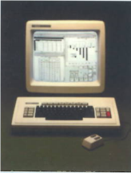
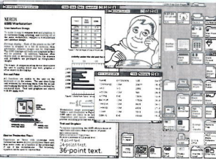
CONCEPTUAL MODELS
Example of a conceptual model ( continue) : The Star Interface ( See Figure 02.01)
a. The Xerox Star
b. GUI Interface
Figure 02.01 The Star Interfaces

Slide 9
INTERFACE METAPHOR
Interface metaphor :
  Intended to provide familiar entities that enable people to readily understand the underlying conceptual model and know what to at an interface.
Designers can fall into the trap of trying to create a virtual object to resemble a familiar physical object that is itself badly designed.
A well-known example is the virtual calculator, which is designed to look and behave like a physical calculator.

Slide 10
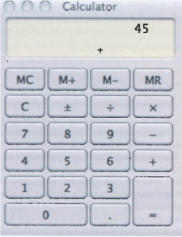
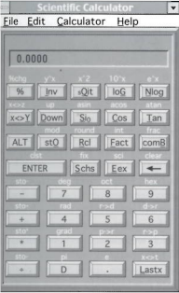
INTERFACE METAPHOR
In figure 02.02 the Mac calculator has simpler interface that supports a basic set of calculations which all that most people need to do.
In figure 02.03 the design of Scientific calculator has even gone as far as replicating functions needing shift keys
Figure 02.02 The Mac Calculator
Figure 02.03 Scientific Calculator

Slide 11
INTERACTION TYPES
Interaction Types : there are the ways a person interacts with a product or application.
There are four main types :
  Instructing
  Conversing
  Manipulating
  Exploring

Slide 12
INTERACTION TYPES
INTRUCTING
This type of interaction describes how users carry out their tasks by telling the system what to do .
This can be done in a number of ways, including :
  Typing in commands
  Selection options from menus
  Speaking aloud commands
  Gesturing
  Pressing buttons or using a combinations of function keys

Slide 13
INTERACTION TYPES
INTRUCTING
Example :
  Operating systems like Unix and Linux where users issue instruction at the prompt as a command or set of commands.
  In Windows use control keys or the selection of menu options via a mouse, touch pad, touch screen

Slide 14
INTERACTION TYPES
INTRUCTING
One the main benefits of instruction is :
  The interaction is quick and efficient
  It is particularly fitting where there is a need to frequently repeat actions performed on multiple objects.
  Examples includes the repetitive actions of saving, deleting and organizing files.

Slide 15
INTERACTION TYPES
CONVERSING
This form of interaction is based on the idea of a person having a conversation with a system, where the system acts as a dialog partner.
The system is designed to respond in a way another human being might when having a conversations.
It differs from the activity of instructing as it encompasses a two-way communication process with the system acting like a partner rather than a machine that obeys orders.

Slide 16
INTERACTION TYPES
CONVERSING
The kind of conversation :
  Simple voice-recognition
  Menu-driven systems with via phones
  More complex natural-language based systems that involve system parsing and responding to queries typed by the user.
The main benefit uses a conversational style is : allow people especially novices, to interact with a system in a way that is familiar to them.

Slide 17
INTERACTION TYPES
CONVERSING
The example :
  The search engine Ask Jeeves for Kids
  (www.askjeeves.com)
  Online agents, Anna in IKEA help Center (www.ikea.com)
A problem that can arise from using a conversational-based interaction type :
  Certain kinds of task are transformed into cumbersome and one-sided interaction. Example : automated phone based systems

Slide 18
INTERACTION TYPES
MANIPULATING
This form of interaction involves manipulating objects and capitalizes on users’ knowledge of how they do so in the physical world. For example digital objects can be manipulated by moving, opening, holding, closing, placing)
Actions that are not possible with objects in the real world such as zooming in and out, stretching and shrinking can done with this form of interaction.

Slide 19
INTERACTION TYPES
MANIPULATING
Direct Manipulation : A framework that has been highly influential in informing the design of GUI application . ( Sneiderman,1983).
Direct manipulation interfaces are assumed to enable users to feel that they are directly controlling the digital objects represented by the computer.

Slide 20
INTERACTION TYPES
MANIPULATING
The three core principles are :
  Continuous representation of the objects and actions of interest.
  Rapid reversible incremental actions with immediate feedback about the objet of interest.
  Physical actions and button pressing instead of issuing commands with complex syntax.

Slide 21
INTERACTION TYPES
MANIPULATING
The benefits of direct manipulation :
  Helping beginners learn basic functionality rapidly.
  Enabling experienced users to work rapidly
  Allowing infrequent users to remember how to carry out operations over time
  Preventing the need for error messages
  Showing users immediately how their actions are furthering their goals
  Reducing users’ experience of anxiety
  Helping users gain confidence and mastery and feel in control

Slide 22
INTERACTION TYPES
MANIPULATING
Apple was one the first computer companies to design an operating environment that used direct manipulation as its central mode of interaction.
Application that used direct manipulation interfaces such word processor, video games, leaning tools, and image editing tools.
In particular, not all task can be described by objects and not all actions can be undertaken directly.

Slide 23
INTERACTION TYPES
EXPLORING
This mode of interaction involves users moving though virtual or physical environments
For example , users can explore aspects of a virtual 3D environment, such as the interior of a building.
Similar to direct manipulation and direct manipulative, the fundamental idea is to enable people to explore and interact with an environment, be it physical or digital, by exploiting their knowledge of how they move and navigate through existing spaces.

Slide 24
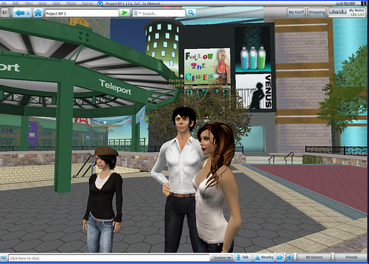
INTERACTION TYPES
EXPLORING
Many 3D virtual environments have been built : virtual universities, virtual parties, Second LIFE ( Figure 2.4).
Figure 2.4 Second Life
Source : www.ubernoggin.com

Slide 25
^{PARADIGMS , THEORIES,}
^{MODELS AND FRAMEWORKS}
PARADIGMS
Other sources of inspiration and knowledge that are used to inform design and guide research are paradigms, theories, models and frameworks
( Carroll,2003)
A paradigms refers to a general approach that has been adopted by a community of researchers and designers for carrying out their work.
In the 1980s, the prevailing paradigm in human computer interaction was how to design user-centered application for the desktop computer.

Slide 26
^{PARADIGMS , THEORIES,}
^{MODELS AND FRAMEWORKS}
PARADIGMS
1980s :
  Task analytic and usability methods were developed based on individual user’s cognitive capabilities
  The acronym WIMP ( Window, Icons, Menus, and Pointer was used as a way of characterizing the core features of an interface for a single user.
  It was later superseded by the GUI (Graphical User Interface).

Slide 27
^{PARADIGMS , THEORIES,}
^{MODELS AND FRAMEWORKS}
PARADIGMS
1990s
  A big influence in the more recent paradigmatic changes was Weiser’s vision of ubiquitous technology.
  Weiser proposed that computers would become part of the environment, embedded in a variety of everyday objects, devices, and displays.
  Since the late 1990s many researcher have been concerned with how to embed and augment the environment with various computational resources to provide information and services when and where desired.

Slide 28
^{PARADIGMS , THEORIES,}
^{MODELS AND FRAMEWORKS}
PARADIGMS
1990s
  A big influence in the more recent paradigmatic changes was Weiser’s vision of ubiquitous technology.
  Weiser proposed that computers would become part of the environment, embedded in a variety of everyday objects, devices, and displays.
  Since the late 1990s many researcher have been concerned with how to embed and augment the environment with various computational resources to provide information and services when and where desired.

Slide 29
^{PARADIGMS , THEORIES,}
^{MODELS AND FRAMEWORKS}
THEORIES
a theory is a well-substantiated explanation of some aspect of a phenomenon.
For example : cognitive theories about human memory were used in the 1980s to determine the best ways of representing operations, given people’s memory limitations.
One of the main benefits of applying such theories in interaction design is :
  To help identify factors ( cognitive, social and affective) relevant to the design and evaluation of interactive products.

Slide 30
^{PARADIGMS , THEORIES,}
^{MODELS AND FRAMEWORKS}
MODELS
A Model is a simplification of some aspect of human-computer interaction intended to make it easier for designer to predict and evaluate alternative designs.
Example :
  Norman ( 1988) develop a number of models of user interaction based on theories of cognitive processing.
  Card, Moran, and Newell’s keystroke model ( 1980) that used by a number of researchers and designers as a predictive way of analyzing user performance for different interfaces to determine which would be the most effective.

Slide 31
^{PARADIGMS , THEORIES,}
^{MODELS AND FRAMEWORKS}
FRAMEWORKS
A Framework is a set of interrelated concepts and / or a set of specific questions that is intended to inform a particular domain area, online communities, or an analytic method ( e.g. ethnographic studies).
A Framework offers advice to designers as to what to design or look for.
Framework based on theories of human behavior, but increasingly being developed from the experiences of actual design practice and the findings arising from user studies.

Slide 32
^{PARADIGMS , THEORIES,}
^{MODELS AND FRAMEWORKS}
FRAMEWORKS
For example Table 2.1 shows part of a new framework proposed for human-computer interaction contrasting old and new concepts
( Rogers,2009)
Concern | Past | Future
Frame of reference | Users | context
Method, theory, perspective | - Scientific approach - Interaction design | - Pluralistic - Mixing
Output | Ethnographies Models and tools for analysis Design guidance | Insights Creating new ways of experiencing Value-based analyses

Slide 33
^{PARADIGMS , THEORIES,}
^{MODELS AND FRAMEWORKS}
FRAMEWORKS
The framework of Normans ( 1988) :
  explication of the relationship between the design of a conceptual model and a user’s understanding of it.
  Comprises three interacting components :
    the designer’s model
      The model the designer has of how the system should work.
    The system image
    how the system actually works is portrayed to the user through the interface, manuals, help facilities, and so on.

Slide 34
^{PARADIGMS , THEORIES,}
^{MODELS AND FRAMEWORKS}
FRAMEWORKS
  Comprises three interacting components :
    The user’s model :
      How the user understands how the system works.
  This framework makes explicit the relationship between how a system should function, how It is presented to users, and how it is understood by them.

Slide 35
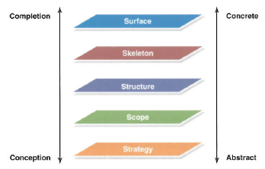
^{PARADIGMS , THEORIES,}
^{MODELS AND FRAMEWORKS}
FRAMEWORKS
Recent framework in design practice is Garrett’s (2010) user experience development process. (Figure 2.5)
The framework has been used primarily to guide web development and understand the elements of the user experience.
Figure 2.5 The user experience framework

Slide 36
^{REFERENCES}
http://www.mif.vu.lt/~moroz/HCI/4_conceptualization.pdf
www.csdl.tamu.edu/~furuta/courses/04a_436/chapters/ch02/ch02.ppt
https://www.cs.indiana.edu/~rawlins/website/interface/game.html
http://www.gamestudies.org/0301/manninen/

